Slide 1
Collections

Slide 2
Why collections?
Collections are used to hold a collection of objects.
List holds objects based on order of insertion and can hold non unique collection
Set holds objects without any order and are unique
Maps holds objects based on a key and value pair, unique key and no specific order

Slide 3
Why collections?
Arrays are not resizable.
Java Collections Framework provides lots of different useful data types, such as linked lists (allows insertion anywhere in constant time), re-sizeable array lists (like Vector but cooler), red-black trees, hash-based maps (like Hashtable but cooler).

Slide 4
Why collections?
Java Collections Framework provides abstractions, so you can refer to a list as a List, whether backed by an array list or a linked list; and you can refer to a map/dictionary as a Map, whether backed by a red-black tree or a hashtable.
Java Collections Framework allows you to use the right data structure, because one size does not fit all.

Slide 5
Different Collections Interfaces
List
Set
Maps

Slide 6
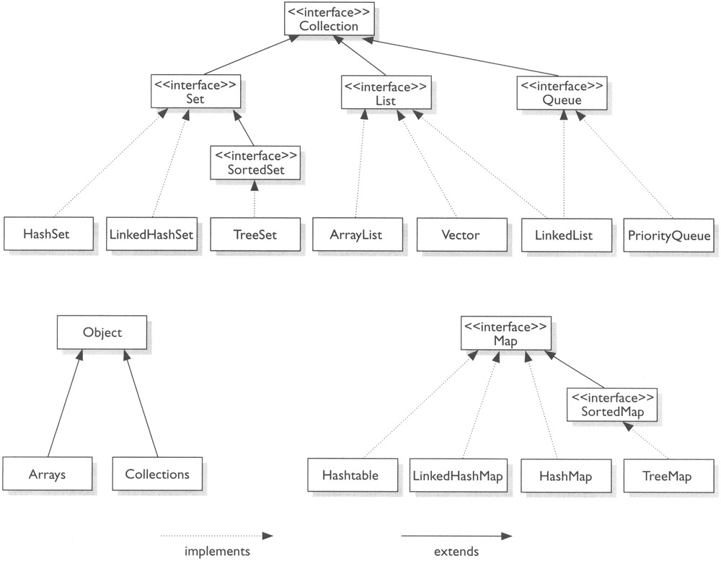
Hierarchy

Slide 7
List
List is an interface with ArrayList, Vector and LinkedList as concrete implementations.
List hold objects based on the insertion order and are non unique.
Vector is deprecated
Depending on the requirement ArrayList or LinkedList is used.
Arraylist is used when more retrievals and less removals
Linkedlist is used when more removals and less retrievals

Slide 8
Array List
ArrayList is a part of collection framework and is present in java.util package.
It provides us dynamic arrays in Java.
Though, it may be slower than standard arrays but can be helpful in programs where lots of manipulation in the array is needed.
ArrayList inherits AbstractList class and implements List interface.
ArrayList is initialized by a size, however the size can increase if collection grows or shrunk if objects are removed from the collection.
Java ArrayList allows us to randomly access the list.
ArrayList can not be used for primitive types, like int, char, etc. We need a wrapper class for such cases.

Slide 9
Array List
Constructors in Java ArrayList:
ArrayList(): This constructor is used to build an empty array list
ArrayList(Collection c): This constructor is used to build an array list initialized with the elements from collection c
ArrayList(int capacity): This constructor is used to build an array list with initial capacity being specified

Slide 10
Array List
Array is that it has a fixed length whereas ArrayList can dynamically grow and shrink after addition and removal of elements.
Arraylist class implements List interface and it is based on an Array data structure.
Array List declaration:
ArrayList<String> obj = new ArrayList<String>();
ArrayList<Integer> list=new ArrayList<Integer>();
List<String> obj = new ArrayList<String>();
The type that a list can contain is given between the diamond brackets.

Slide 11
Array List
Methods in Java ArrayList:
void clear(): This method is used to remove all the elements from any list.
void add(int index, Object element): This method is used to insert a specific element at a specific position index in a list.
void trimToSize(): This method is used to trim the capacity of the instance of the ArrayLis to the list’s current size.
int indexOf(Object O): The index the first occurrence of a specific element is either returned, or -1 in case the element is not in the list.
int lastIndexOf(Object O): The index the last occurrence of a specific element is either returned, or -1 in case the element is not in the list.
Object remove(int index): This method removes an element from the specified index. It shifts subsequent elements(if any) to left and decreases their indexes by 1.
Object[] toArray(): This method is used to return an array containing all of the elements in the list in correct order.
Object get(int index): This method returns element at the specified index.
boolean addAll(Collection C): This method is used to append all the elements from a specific collection to the end of the mentioned list, in such a order that the values are returned by the specified collection’s iterator.
boolean add(Object o): This method is used to append a specificd element to the end of a list.
boolean addAll(int index, Collection C): Used to insert all of the elements starting at the specified position from a specific collection into the mentioned list.

Slide 12
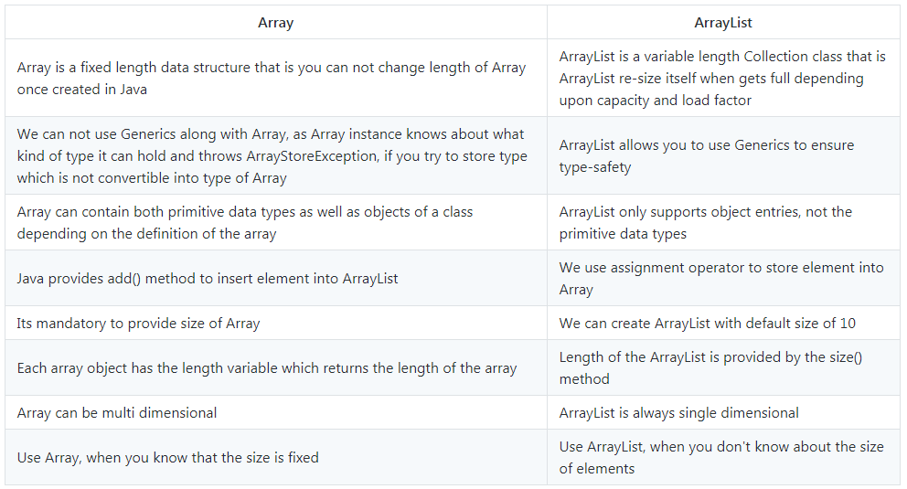

Slide 13
Linked List
Linked List is a doubly linked list in Java.
Insertions and removals of elements take constant time.
Linked lists provide sequential access to their elements, which means that grabbing elements takes linear time.
Because linked lists need extra storage for references, they are impractical for lists of small data items such as characters.

Slide 14
Set
A set interface has concrete implementation of HashSet, LinkedHashSet and TreeSet.
The HashSet holds objects in no specific order (random order) and holds a unique set of objects.
There is no get method in the Set interface. You will need to iterate over the set to get your object.
Hence Set is used only as a collection of objects.
A TreeSet stores objects in a sorted order. Every object to be inserted in the TreeSet has to implement the Comparable or Comparator interface else would result in a classcastexception.

Slide 15
Set
Set is an interface which extends Collection. It is an unordered collection of objects in which duplicate values cannot be stored.
Basically, Set is implemented by HashSet, LinkedHashSet or TreeSet (sorted representation).
Set has various methods to add, remove clear, size, etc to enhance the usage of this interface.

Slide 16
Set
HashSet doesn’t maintain any kind of order of its elements.
TreeSet sorts the elements in ascending order.
LinkedHashSet maintains the insertion order.
A HashSet is unordered and unsorted Set.
The only difference between HashSet and LinkedHashSet is that LinkedHashSet maintains the insertion order.

Slide 17
Set
Sr.No. | Method & Description
1 | add( ) Adds an object to the collection.
2 | clear( ) Removes all objects from the collection.
3 | contains( ) Returns true if a specified object is an element within the collection.
4 | isEmpty( ) Returns true if the collection has no elements.
5 | iterator( ) Returns an Iterator object for the collection, which may be used to retrieve an object.
6 | remove( ) Removes a specified object from the collection.
7 | size( ) Returns the number of elements in the collection.

Slide 18
Set example
class mysetExample{
public static void main(String args[]){
Set myset = new HashSet(); // create a hashset
Object o = new Object(); // create an object
boolean add = myset.add(o); // add object
boolean addagain myset.add(o); // add object again
Iterator iter = myset.iterator(); // extract the iterator
while(iter.hasNext()){
Object o = (Object)iter.next(); // Iterate over the collection
}
}
}
In this example we are creating a hashset and adding an object to it.
The value of add will be true and the value of addagain will be false as the same object is already available in the set
The iterator iterates over all the available objects in the set
The equality of the objects is bounded by the equals(Object) and the hashcode() contract.

Slide 19
Map
A map contains values on the basis of key i.e. key and value pair. Each key and value pair is known as an entry. Map contains only unique keys.
Map is useful if you have to search, update or delete elements on the basis of key.
The Map Interface has implementations HashMap, LinkedHashMap, TreeMap and Hashtable.
Map doesn't allow duplicate keys, but you can have duplicate values. HashMap and LinkedHashMap allows null keys and values but TreeMap doesn't allow any null key or value.

Slide 20
Map
HashMap vs HashTable
HashMap is non synchronized. It is not-thread safe and can’t be shared between many threads without proper synchronization code whereas Hashtable is synchronized. It is thread-safe and can be shared with many threads.
2. HashMap allows one null key and multiple null values whereas Hashtable doesn’t allow any null key or value.
3. HashMap is generally preferred over HashTable if thread synchronization is not needed

Slide 21
Map
Map can't be traversed so you need to convert it into Set using keySet() or entrySet() method.
The Map takes in a key and value pair as input for storage.
The value can be retrieved if the key is known.
The Map does not maintain order and should have unique keys.

Slide 22
Map
HashMap is implemented as a hash table, and there is no ordering on keys or values.
TreeMap stores key, values in the sorted order based on custom ordering (it is ordered by the key)
LinkedHashMap preserves the insertion order
Hashtable is synchronized, in contrast to HashMap.

Slide 23
Map
Map.Entry Interface
Entry is the sub interface of Map. So we will be accessed it by Map.Entry name. It provides methods to get key and value.
Methods of Map.Entry Interface:
Method | Description
Object getKey() | It is used to obtain key.
Object getValue() | It is used to obtain value.

Slide 24
Map
Class | Description
HashMap | HashMap is the implementation of Map but it doesn't maintain any order.
LinkedHashMap | LinkedHashMap is the implementation of Map, it inherits HashMap class. It maintains insertion order.
TreeMap | TreeMap is the implementation of Map and SortedMap, it maintains ascending order.

Slide 25
Map
Methods in Map Interface:
public Object put(Object key, Object value): This method is used to insert an entry in this map.
public void putAll(Map map): This method is used to insert the specified map in this map.
public Object remove(Object key): This method is used to delete an entry for the specified key.
public Object get(Object key):This method is used to return the value for the specified key.
public boolean containsKey(Object key): This method is used to search the specified key from this map.
public Set keySet(): This method is used to return the Set view containing all the keys.
public Set entrySet(): This method is used to return the Set view containing all the keys and values.

Slide 26
LinkedHashMap
Apart from the methods inherited from its parent classes, LinkedHashMap defines the following methods −
Sr.No. | Method & Description
1 | void clear() Removes all mappings from this map.
2 | boolean containsKey(Object key) Returns true if this map maps one or more keys to the specified value.
3 | Object get(Object key) Returns the value to which this map maps the specified key.
4 | protected boolean removeEldestEntry(Map.Entry eldest) Returns true if this map should remove its eldest entry.

Slide 27
Linked Hash Map
This class extends HashMap and maintains a linked list of the entries in the map, in the order in which they were inserted. This allows insertion-order iteration over the map. That is, when iterating a LinkedHashMap, the elements will be returned in the order in which they were inserted.
Sr.No. | Constructor & Description
1 | LinkedHashMap( ) This constructor constructs a default LinkedHashMap.
2 | LinkedHashMap(Map m) This constructor initializes the LinkedHashMap with the elements from the given Map class m.
3 | LinkedHashMap(int capacity) This constructor initializes a LinkedHashMap with the given capacity.
4 | LinkedHashMap(int capacity, float fillRatio) This constructor initializes both the capacity and the fill ratio. The meaning of capacity and fill ratio are the same as for HashMap.
5 | LinkedHashMap(int capacity, float fillRatio, boolean Order) This constructor allows you to specify whether the elements will be stored in the linked list by insertion order, or by order of last access. If Order is true, then access order is used. If Order is false, then insertion order is used.

Slide 28
TreeMap
Methods of TreeMap:
boolean containsKey(Object key): Returns true if this map contains a mapping for the specified key.
boolean containsValue(Object value): Returns true if this map maps one or more keys to the specified value.
Object firstKey(): Returns the first (lowest) key currently in this sorted map.
Object get(Object key): Returns the value to which this map maps the specified key.
Object lastKey(): Returns the last (highest) key currently in this sorted map.
Object remove(Object key): Removes the mapping for this key from this TreeMap if present.
void putAll(Map map): Copies all of the mappings from the specified map to this map.
Set entrySet(): Returns a set view of the mappings contained in this map.
int size(): Returns the number of key-value mappings in this map.
Collection values(): Returns a collection view of the values contained in this map.
Object clone(): The method returns a shallow copy of this TreeMap.
void clear(): The method removes all mappings from this TreeMap and clears the map.
SortedMap headMap(Object key_value): The method returns a view of the portion of the map strictly less than the parameter key_value.
Set keySet(): The method returns a Set view of the keys contained in the treemap.
Object put(Object key, Object value): The method is used to insert a mapping into a map
SortedMap subMap((K startKey, K endKey): The method returns the portion of this map whose keys range from startKey, inclusive, to endKey, exclusive.
Object firstKey(): The method returns the first key currently in this tree map.

